Slide 1




PIZZA
Sales Report

Slide 2
HELLO!
My name is Pradeep Kumar Mohanty, in this project i have utilized SQL Queries to solve pizza sales and taking some insights

Slide 3
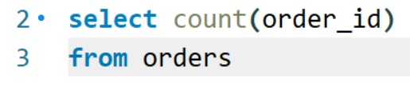
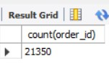
Retrieve the total number of orders placed.
Retrieve the total number of orders placed.

Slide 4
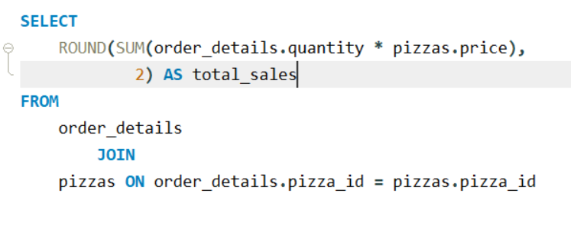
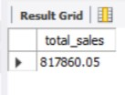
Retrieve the total number of orders placed.
Calculate the total revenue generated from pizza sales.

Slide 5
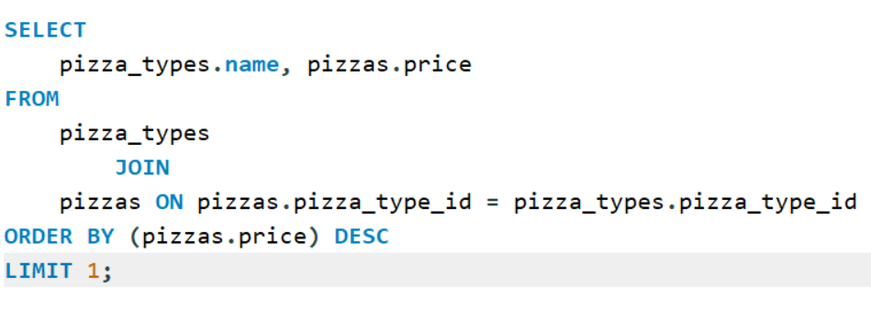

Retrieve the total number of orders placed.
Identify the highest-priced pizza.

Slide 6
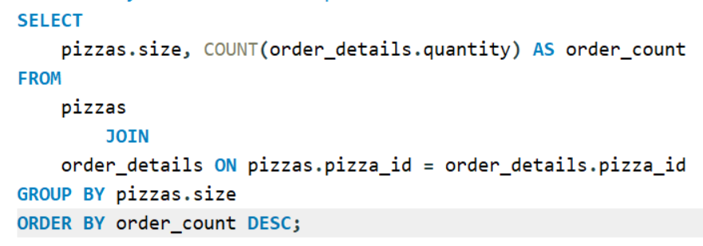
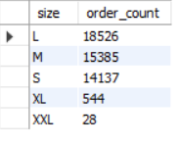
Retrieve the total number of orders placed.
Identify the most common pizza size ordered.

Slide 7
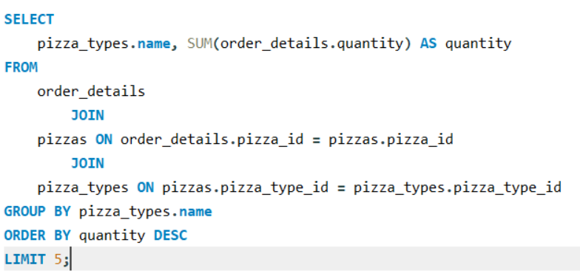
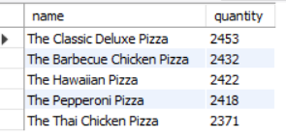
Retrieve the total number of orders placed.
List the top 5 most ordered pizza types along with their quantities.

Slide 8
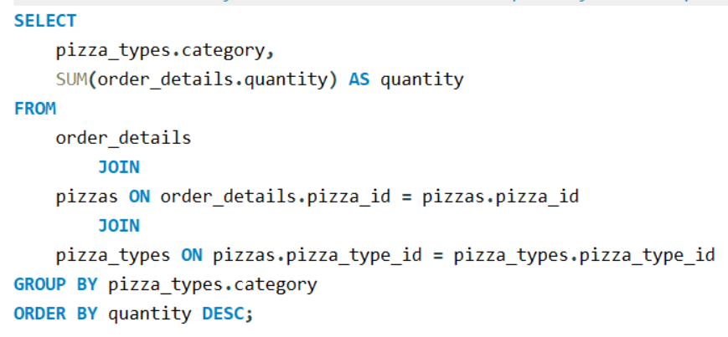
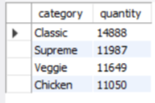
Retrieve the total number of orders placed.
Join the necessary tables to find the total quantity of each pizza category ordered.

Slide 9
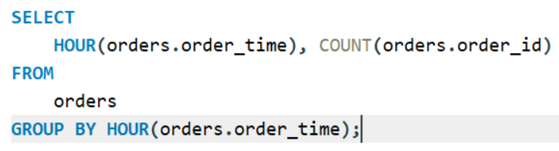
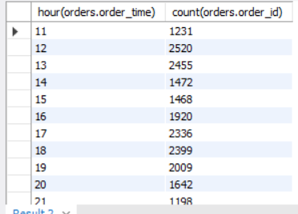
Retrieve the total number of orders placed.
Determine the distribution of orders by hour of the day.

Slide 10
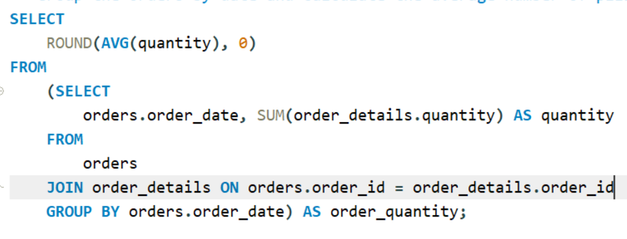
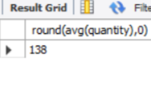
Retrieve the total number of orders placed.
Group the orders by date and calculate the average number of pizzas ordered per day.

Slide 11
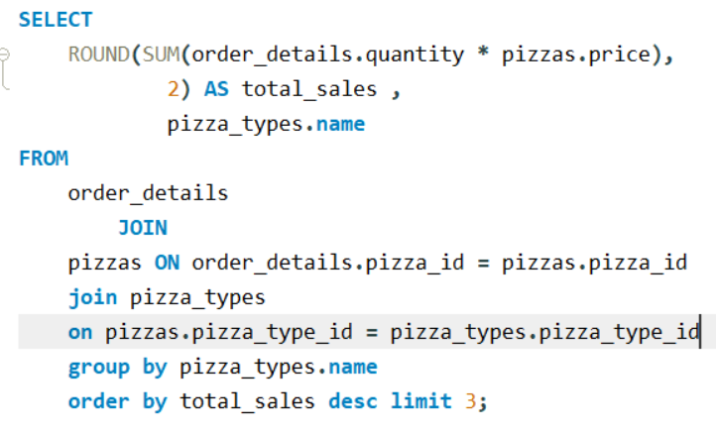

Retrieve the total number of orders placed.
Determine the top 3 most ordered pizza types based on revenue.

Slide 12
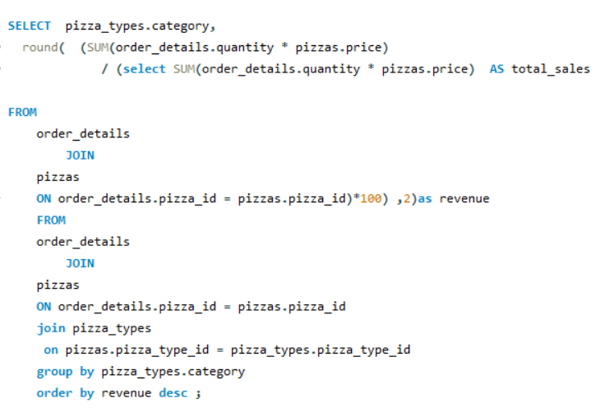
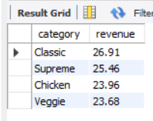
Retrieve the total number of orders placed.
Calculate the percentage contribution of each pizza type to total revenue.

Slide 13
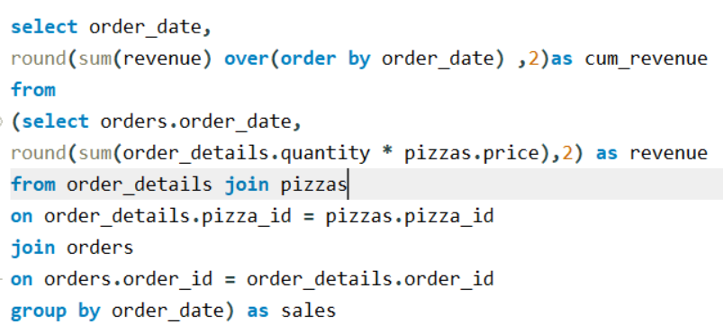
Retrieve the total number of orders placed.
Analyze the cumulative revenue generated over time.

Slide 14
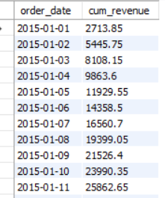
Retrieve the total number of orders placed.
Analyze the cumulative revenue generated over time.

Slide 15
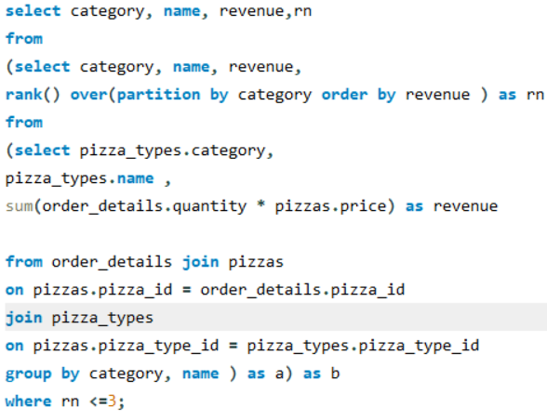
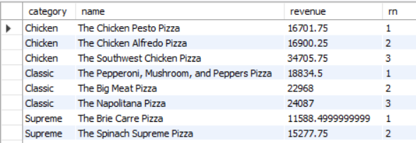
Retrieve the total number of orders placed.
Determine the top 3 most ordered pizza types based on revenue for each pizza category.

Slide 16
CONCLUSION
All question or difficulties were solved using SQL Queries...

Slide 17
THANK YOU

